Slide 1
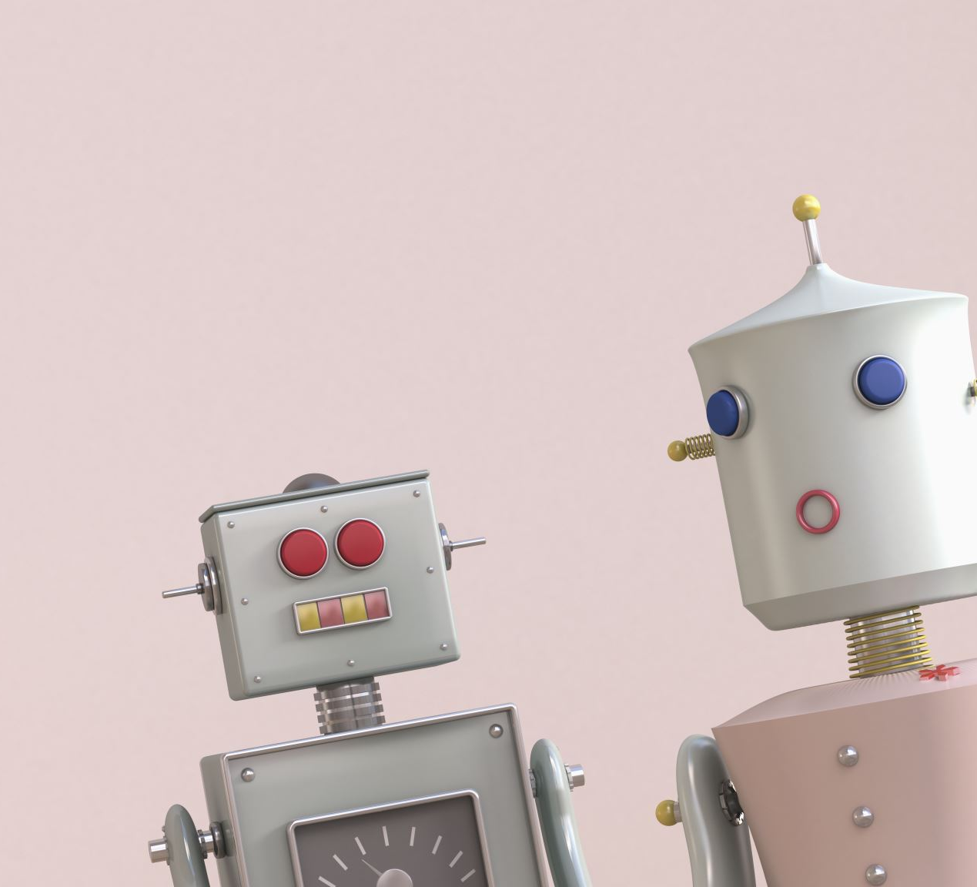
UNIVERSITY INSTITUTE OF COMPUTING
Master of Computer Applications/ Bachelors of Computer Applications/Science
Minor Project
20CAR-719/ CAR-308/SCR-308
COLLEGE ENQUIRY
CHATBOT
SECTION/GROUP: 19BCA-1 (GROUP- 1)
RITIKA RANA – 19BCA1126
ATHARV SINGH – 19BCA1132
PRABHAT Kr. CHAUDHARY - 19BCA1172
Supervisor Name: Mr. Deepak Vats
Employee Code:
Designation: Assistant Professor
Minor Project Presentation

Slide 2
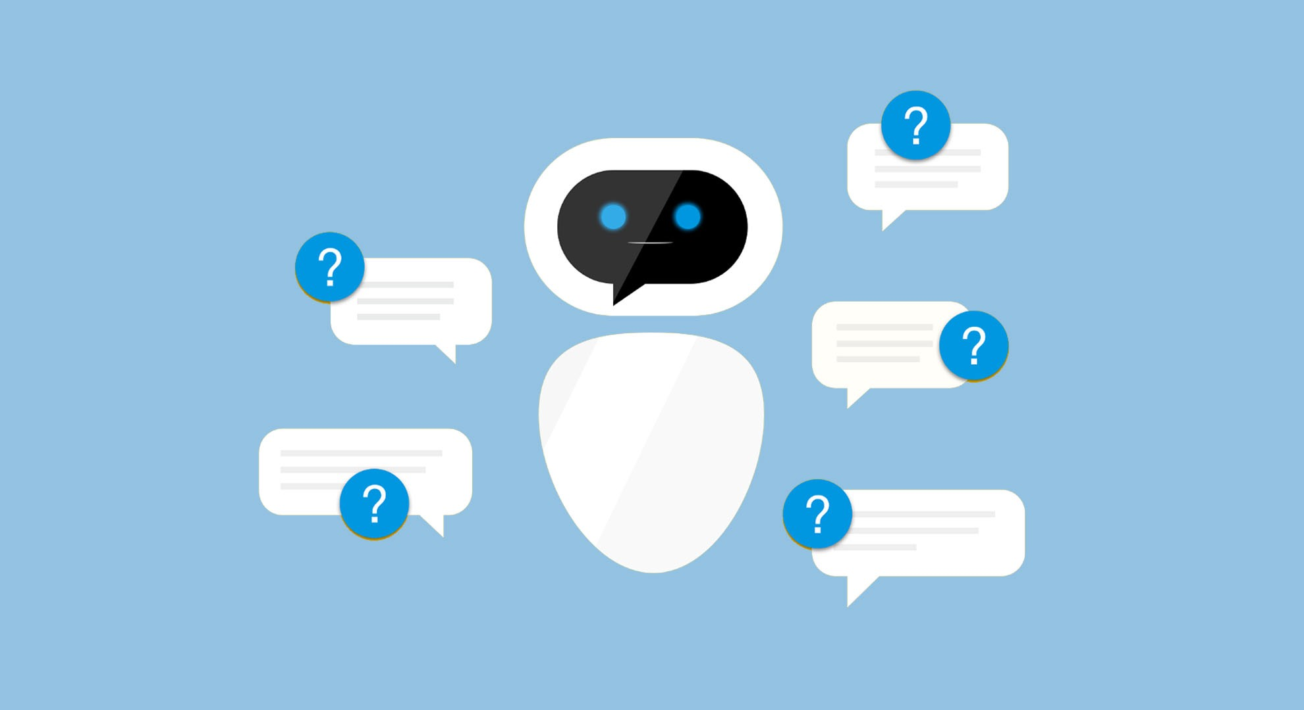
INDEX
•Introduction to Project
•Technology Used
•Existing Gaps & Project Features
•Objectives
•Scope/Relevance
•Project Flow Diagram
•ER Diagrams
•Test Cases
•Comparative Analysis
•Conclusion & Future Aspects
•Bibliography

Slide 3
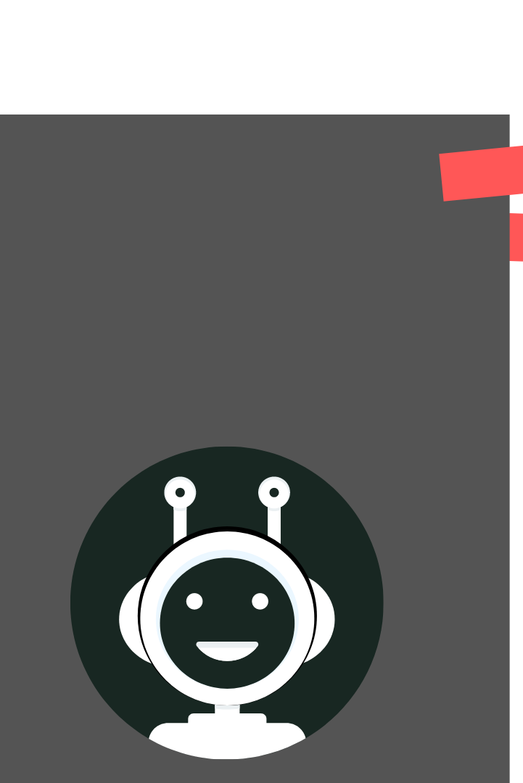
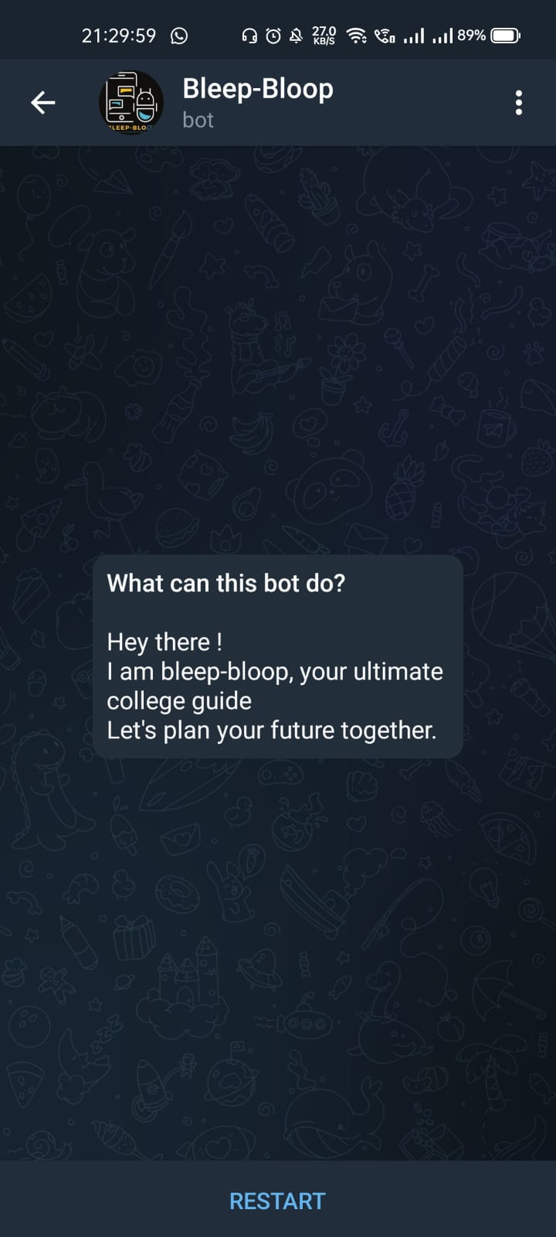
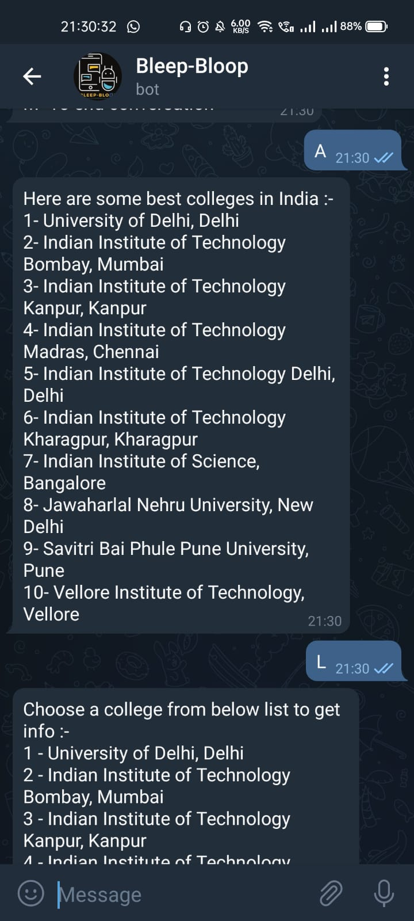
INTRODUCTION TO PROJECT
A chat-bot is a conversational agent that interacts with users using natural language.
Started as an attempt to fool humans.
Numerous applications of chat-bots such as Customer Service, call centres etc.

Slide 4
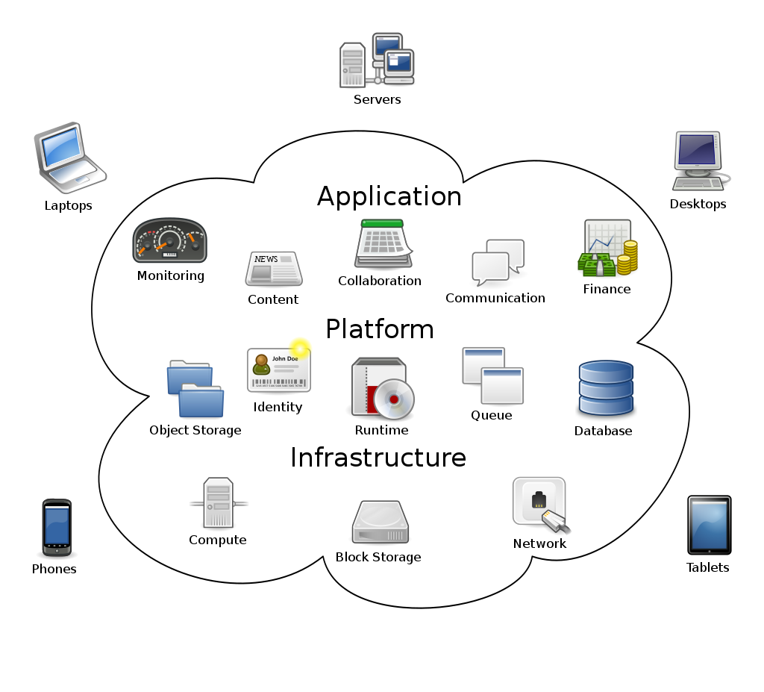
Technology Used
Cloud:
Distributed computing is the on-request accessibility of PC framework assets, particularly information stockpiling (distributed storage) and processing power, without direct dynamic administration by the client. Huge mists frequently have capacities circulated over various areas, every area being a server farm. Distributed computing depends on sharing of assets to accomplish coherence[clarification needed] and economies of scale, normally utilizing a "pay-more only as costs arise" model which can help in decreasing capital costs yet may likewise prompt unforeseen working costs for ignorant.

Slide 5
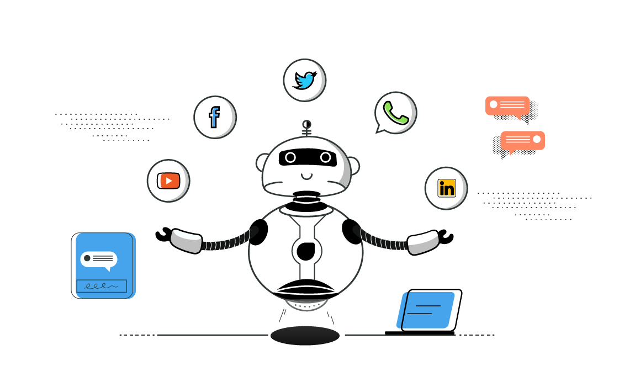
Existing Gaps & Project Features
Rather than visiting loads of sites to look for specific data one can visit a school request talk bot and can get all the minor information they need. With the assistance of a chat-bot, they can ask their questions. Haphazardly posed inquiries is now been added to the chat-bot. Further, as we probably are aware while visiting numerous sites to get definite information we want to ponder such countless sites and keeping in mind that doing this we burn through heaps of our valuable time spending it on the initial site which doesn't require numerous ads which we don't require so school enquiry is without hustle and simple to work by anybody. It is created remembering every one of the limitations looked by understudies.

Slide 6
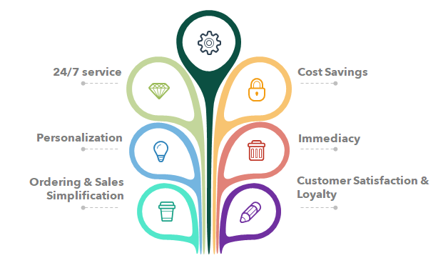
Objectives

Slide 7
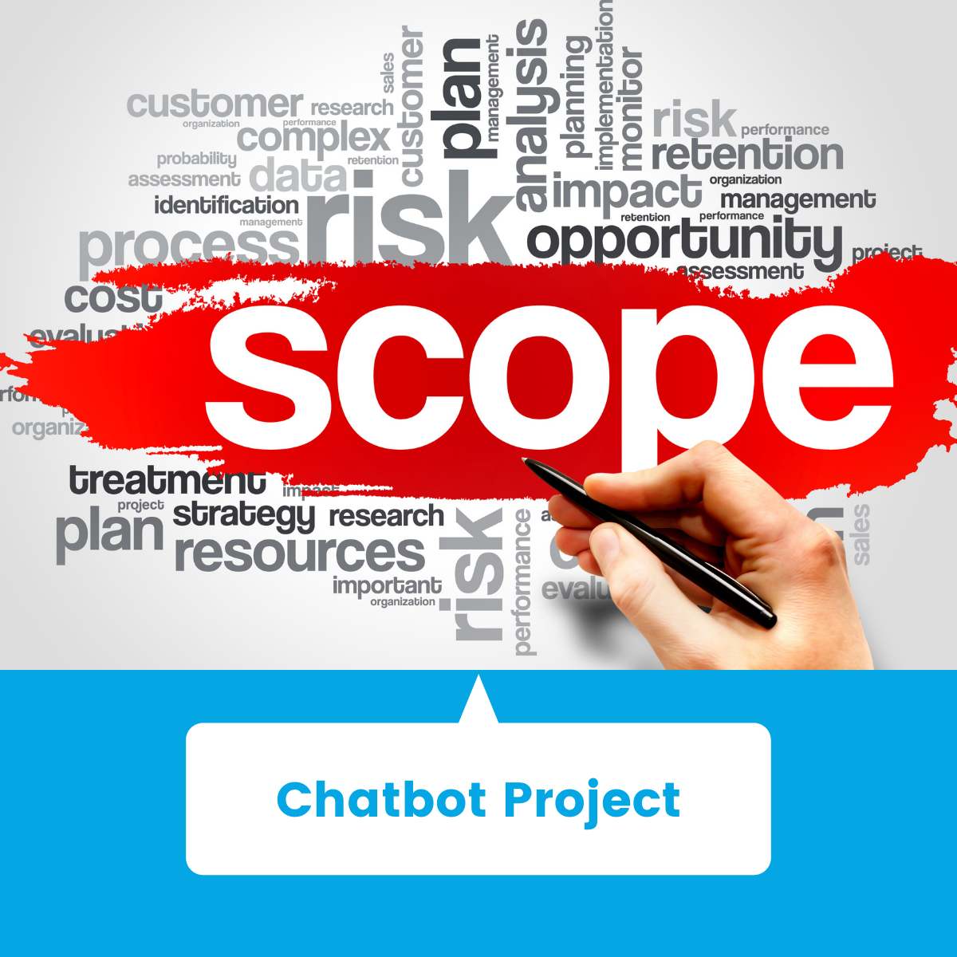
Scope/ Relevance
The College Inquiries Chat-bot project is based on algorithms that analyze and interpret user inquiries and messages.
Given the confusion that is occurring in students' minds about today's situation and which college is best for each course, this chat-bot website is this issue or the confusion of aspiring engineers, CAs, and Designed to address. To overcome more.
Another important goal in developing a university inquiry chat-bot is to avoid going through many websites so that users go directly to the correct page or the official university website.

Slide 8
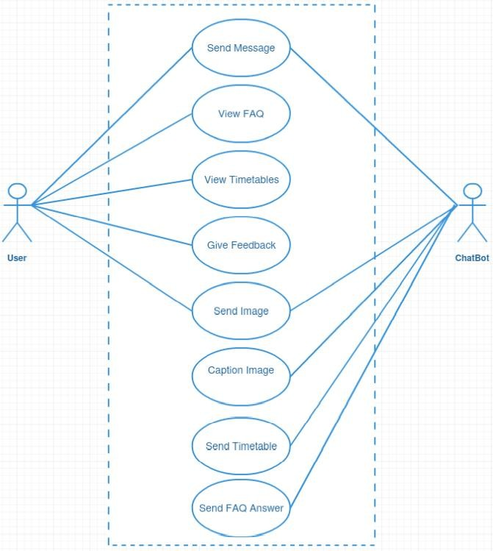
Project Flow Diagram

Slide 9
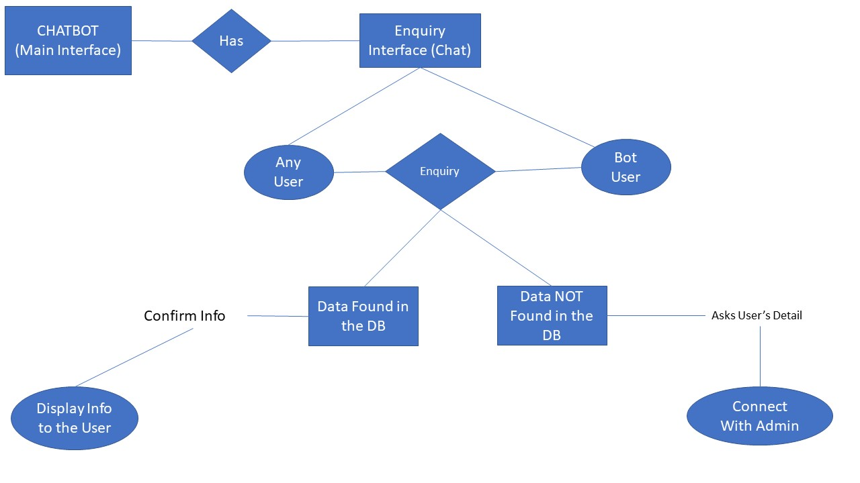
ER Diagram

Slide 10
Test Cases
Functionality Testing
Verified that there is no dead page or invalid redirects.
Verified the working of the system.
Verified data safety.
Interface testing
Performed to verify the interface and the data flow from one system to another like different windows and phones.
Performance testing
Load testing-checked by opening all the posts at the same time and it's working.
Stress testing-checked the limits of the website till which it can handle stress.

Slide 11
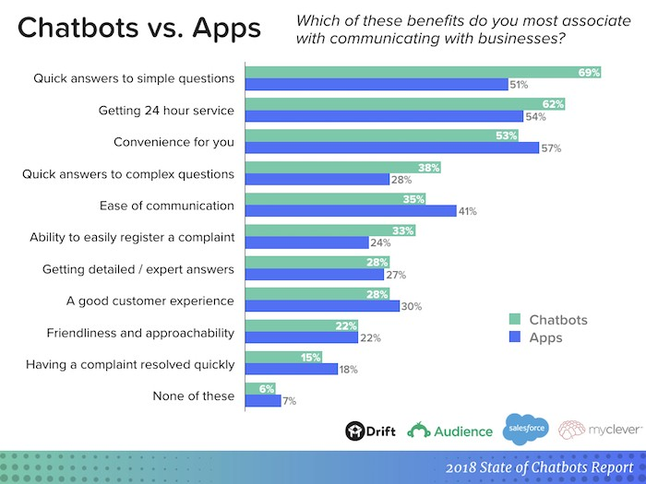
Comparative Analysis

Slide 12
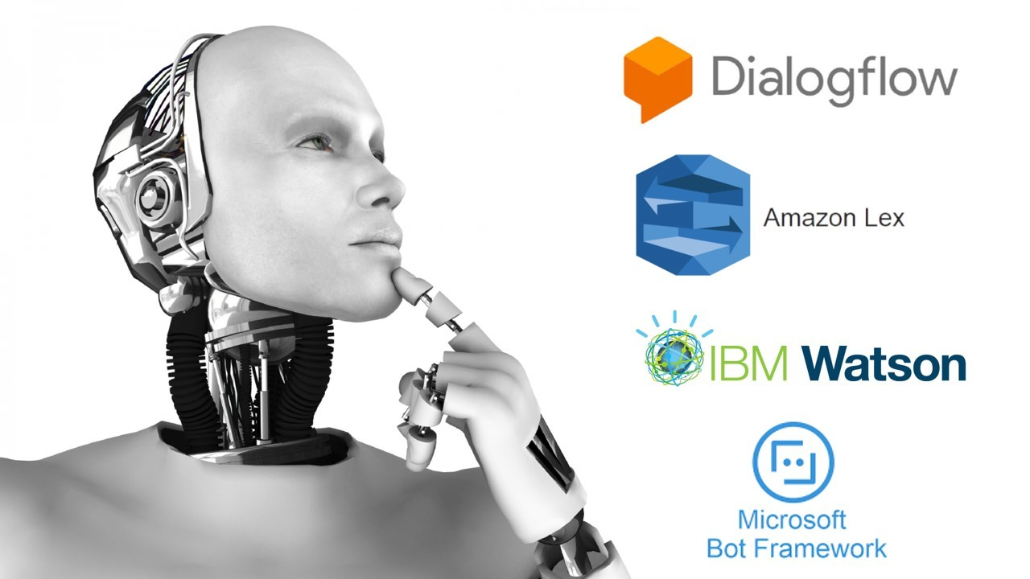
Conclusion & Future Aspects
Chat-bot can reach a large audience through messaging apps and are more effective than humans. They can quickly evolve into powerful tools for information gathering.
Chat-bots are programmed chat interfaces that allow website visitors to interact.
The more conversations you have, the smarter you will be.
Chat-bots get smarter with time.
Link to the chat-bot:
https://t.me/info_college_bot

Slide 13
Bibliography
Google. (n.d.-a). Google Cloud Platform Terms Of Service. Google Cloud. Retrieved September 1, 2021, from https://cloud.google.com/terms
Google. (n.d.-b). Release Notes | Dialogflow Documentation |. Google Cloud. Retrieved September 1, 2021, from https://cloud.google.com/dialogflow/docs/release- notes
Rajesh, R. [&nbsp;Raji&nbsp;Rajesh]. (2021, April 7). Creating Entities and Updating Avatar | Chatbot 2 | Google Dialogflow [Video]. YouTube. https://www.youtube.com/watch?v=yupkCZTp4Ms&feature=youtu.be
Load, E. (2020, May 5). Creating ChatBot || Dialogflow || Just in 30 Minutes.
YouTube.https://www.youtube.com/watch?v=0SDfi3JvacE&feature=youtu.be
Learners, W. (2021, July 22). How to Add A Chatbot to Your Website. YouTube. https://www.youtube.com/watch?v=y0CRhaWNpto&feature=youtu.be
Bergant, Jana. “ChatBots: Messenger ChatBot - DialogFlow and Nodejs | Udemy.”
Udemy, Udemy, Oct. 2021, https://www.udemy.com/course/chatbots/.
“College Reviews – Careers360.Com.” Careers360: Explore Exams, Colleges, Courses and Latest News about Education, Careers360.com, Sept. 2021, https://www.careers360.com/colleges/reviews.
“Step-by-Step Guide On Building a Chatbot Using DialogFlow.” Maruti Techlabs, Maruti Techlabs, 30 Aug. 2019, https://marutitech.com/build-a-chatbot-using- dialogflow/.

Slide 14
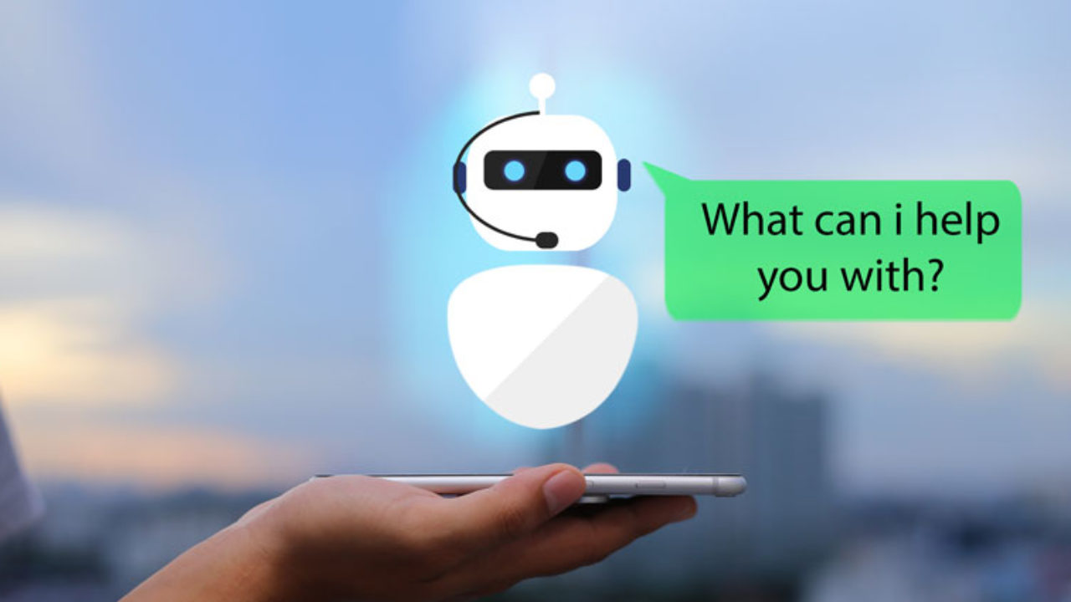
THANK YOU !
FOR YOUR TIME

